Slide 1
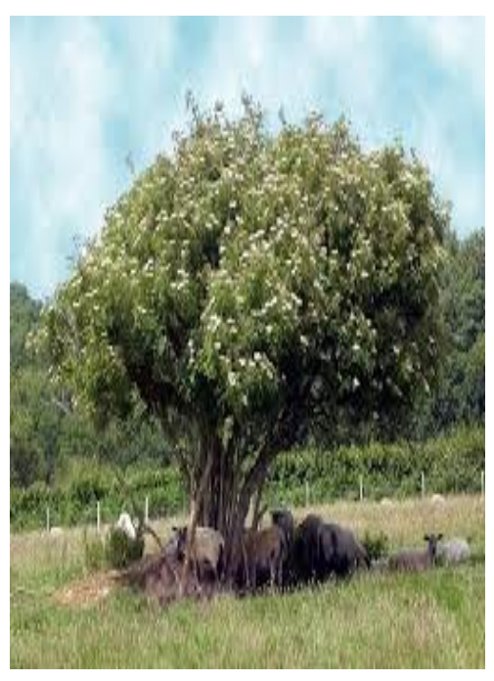
Elder Class Summer: Meet the Teacher 2023

Slide 2
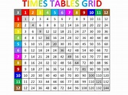
Times tables
Times tables check- recommended website to practise:
https://www.timestables.co.uk/
Between the 24th and 28th April, we are playing against a number of local schools and hope that your child can help us win and may be qualify for the national finals! The competition is based on the use of an online app called “Learning with Emile. Namely those MTC style games that cover all the times tables 2-12 with 6 seconds to answer (indicated with a football icon). As we want to do really well and qualify for the national finals, we’re hoping each child will play Emile (and practise their times tables) regularly.

Slide 3
Year 4 Multiplication Check The statutory Year 4 multiplication test will take place at the beginning of June.

Slide 4
The Curriculum- summer term
Maths- solving problems using information presented in a range of graphs. Identifying the value of digits to two decimal places and ordering and comparing numbers beyond 1000.
English- we will be reading and writing about stories with issues and dilemmas. Later in the year, looking at persuasive language and putting forward a balanced argument. Classical poetry linked to our history topic, The Tudors.
RE- The Commandments and how we are called to Discipleship.
Topic- The Environment and The Tudors
Science- States of Matter
Art- Hans Holbein portraits
DT- Textiles
French- Hobbies and the weather
HRSE- We are all different

Slide 5
Reading
Reading is not only key to learning but is one of life’s pleasures. Therefore, we cannot over emphasise the importance of regular reading and quality discussion.
Your child will be immersed in books in class: class novels linked to our topics, class novels at the end of the day, regular guided reading sessions in small groups at their level and of course, individual reading books.
Your child should be reading at home for about 30 minutes each night. If this is not possible one night, try to read a little more the next night or at the weekend. Try to find some time to listen to reading so that you are able to engage in meaningful discussion. Questions that involve an explanation rather than a one word answer are more beneficial.
Can your child support their opinion using evidence from the text? Are they beginning to use inference and deduction by looking beyond the literal and picking up more subtle clues? I have included some question prompts in their reading diaries.

Slide 6
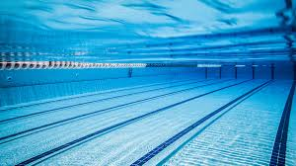
Swimming
During the afternoons of the week commencing 03rd July and 10th July Year 4 will go swimming at Fulwood Leisure Centre.
I will send an email with further information closer to the time but during these two weeks children should come to school in their PE kits.
They need a swimming costume (full piece) or swimming shorts (not loose fitting), swimming hats are compulsory and a towel. Goggles are optional.

Slide 7
Other important dates for this term:
3rd May - May Procession,1:45pm
16th May- Water safety talk
26th May- Sport Day, 1pm
5th May- Coronation activities
Week commencing 5th June- Multiplication check- during the school day
16th June- Corpus Christi Procession, 1:45pm

Slide 8
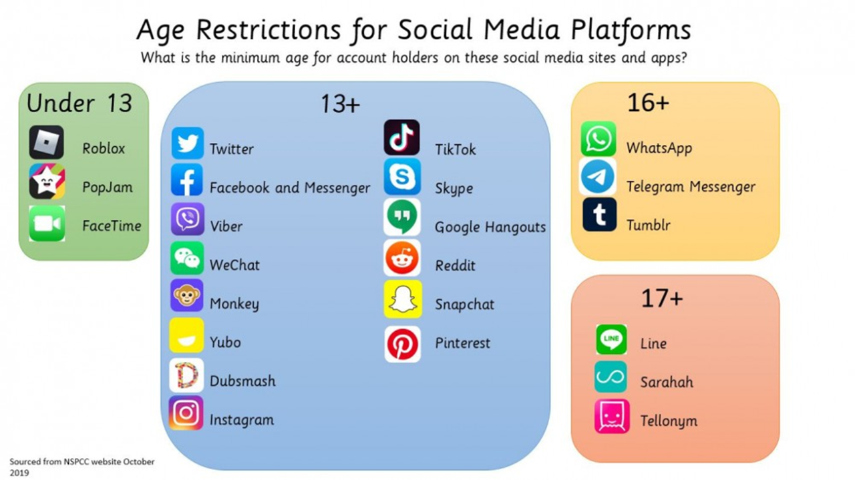

Slide 9
Castlerigg
A letter will be sent home this week with regards to Castlerigg.
The retreat will take place Wednesday 20th September - Friday 22nd September 2023.
A medical and data collection form has been set up on parents pay - This form, along with the forms attached to the initial letter needs completing by Friday 26th May 2023.
Payment details have been set up on parent pay – the deposit of £20 needs to be paid by Monday 1st May 2023 and the final amount needs to be paid by Monday 4th September 2023. Payments can be made in instalments over this time period.
If anyone has any questions or may need any help with payments please talk to Mrs Bridgeman on the playground at the end of the day.

Slide 10
Other Information
Finally, we very much value the partnership we have with parents and we are always happy to discuss any further queries you may have.
Many thanks for your continued support.

Slide 11
Any Questions?

